Slide 1

Inhouse Internship Project
Twitter sentimental analysis

Slide 2
SUBMITTED TO:Prof. Ram murti rawat
SUBMITTED BY:
Sunil sahu
2k18/co/363

Slide 3
Objective
The objective of this project is to show how sentimental analysis can help improve the user experience over a social network or system interface. The learning algorithm will learn what our emotions are from statistical data then perform sentiment analysis. Our main objective is also maintain accuracy in the final result.

Slide 4
The main goal of such a sentiment analysis is to discover how the audience perceives the television show. The Twitter data that is collected will be classified into two categories; positive or negative. An analysis will then be performed on the classified data to investigate what percentage of the audience sample falls into each category. Particular emphasis is placed on evaluating different machine learning algorithms for the task of twitter sentiment analysi
This is also known as opinion mining.

Slide 5
Motivation
The reason why we choose this project was that we spend most of our time nowadays online and because of this there has been an increase in cases of spreading hate.
So if we can successfully classify the data (tweet in this case) into positive and negative sentiment and work around in trying to block the negative data, it will help to reduce hate to a large extent.

Slide 6
WHAT IS SENTIMENTAL ANALYSIS Sentiment analysis is the automated process of identifying and classifying subjective information in text data. This might be an opinion, a judgment, or a feeling about a particular topic or product feature. The most common type of sentiment analysis is ‘polarity detection’ and involves classifying statements as positive, negative or neutral. A polarity sentiment analysis model, for example, automatically tags this tweet as positive:

Slide 7
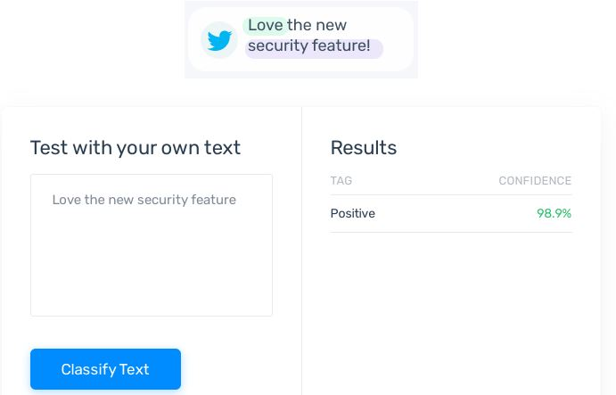

Slide 8
Sentiment analysis uses Natural Language Processing (NLP) to make sense of human language, and machine learning to automatically deliver accurate results.
Connect sentiment analysis tools directly to your social platforms , so you can monitor your tweets as and when they come in, 24/7, and get up-to-the-minute insights from your social mentions.

Slide 9
How to Perform Sentiment Analysis on the Twitter Data Performing sentiment analysis on Twitter data involves five steps: 1. Gather relevant Twitter data 2.Clean your data using pre-processing techniques 3.Create a sentiment analysis machine learning model 4.Analyze your Twitter data using your sentiment analysis model 5.Visualize the results of The Twitter sentiment analysis

Slide 10
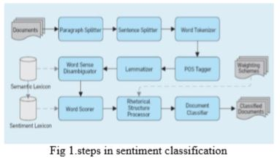
Proposed system

Slide 11
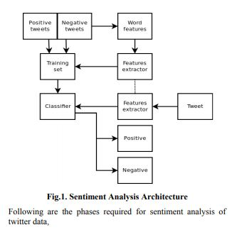
ARCHITECTURE OF TWITTER SENTIMENTAL ANALYSIS

Slide 12
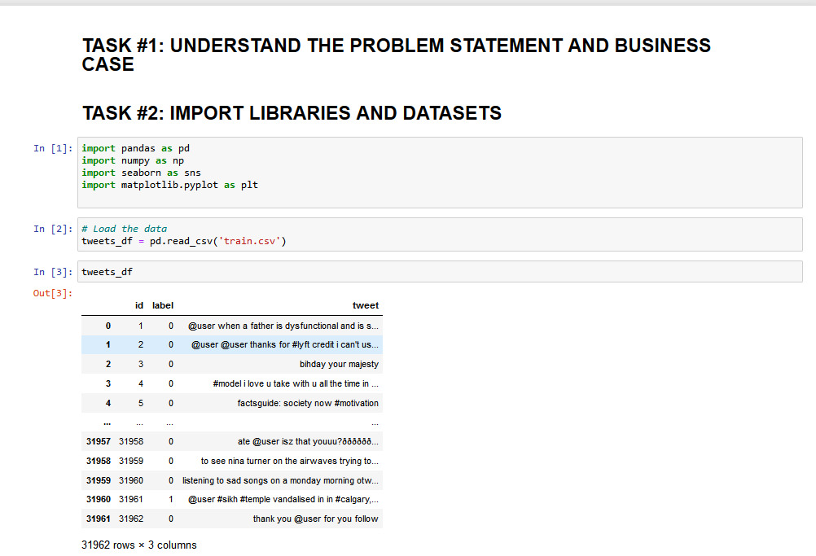
Understanding the problem statement

Slide 13
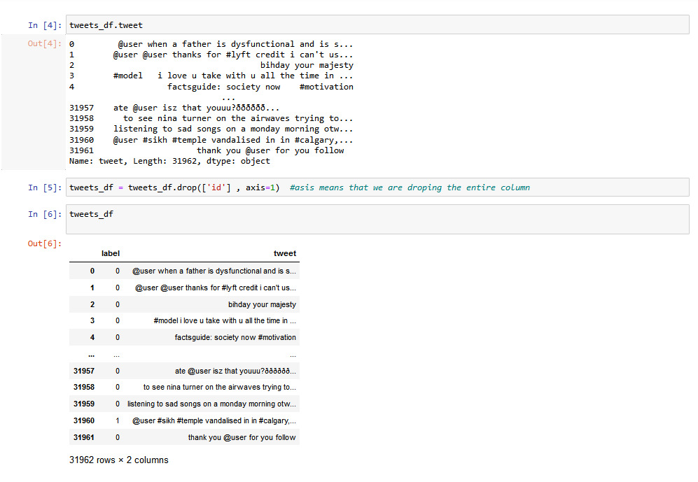

Slide 14
Description of Dataset
We Used a kaggle dataset which had around 32000 tweets, which were labelled as ‘0’ and ‘1’, where ‘0’ being positive and ‘1’ being negative.
We performed pre-processing steps , checked for null values, plotted a graph for the length of the tweets to further understand the dataset
For this Project we just need 2 Parameters:
The tweets itself
The labels associated with each tweet.

Slide 15
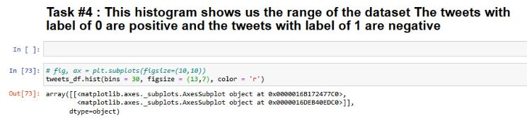
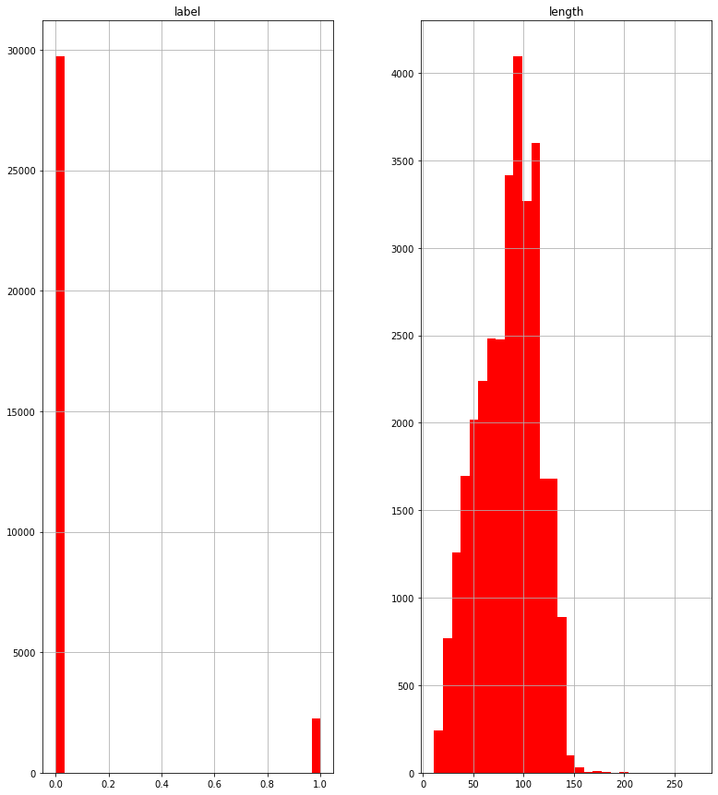

Slide 16
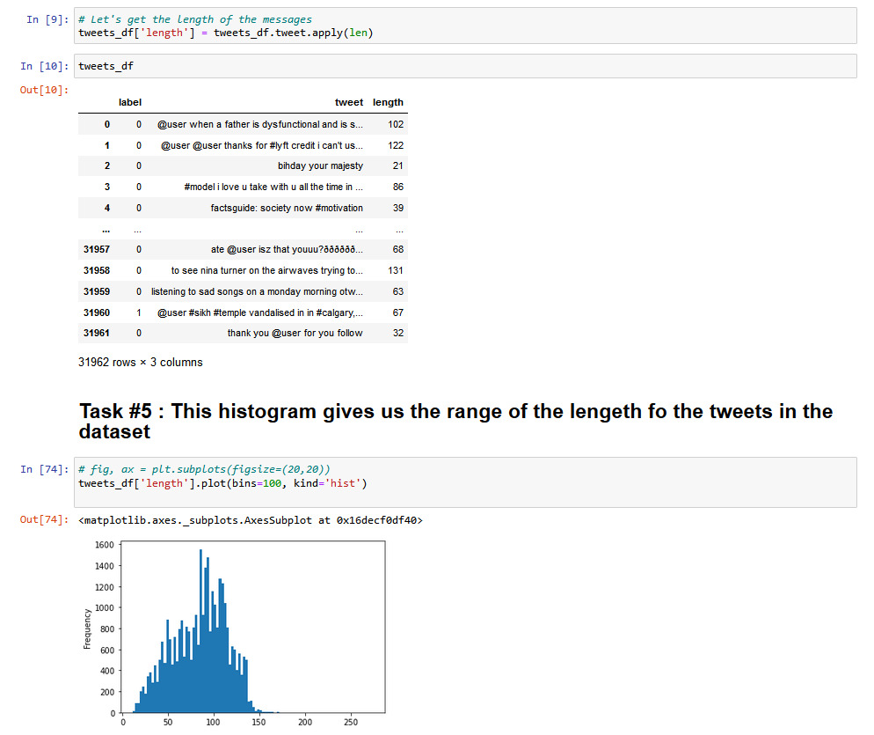

Slide 17
Data Cleaning
In this Project we undertook 3 main data cleaning steps:
Removing frequent Words
Removing Stopwords
Removing Punctuations

Slide 18

We can Clearly see the difference between the tweet before and after cleaning

Slide 19
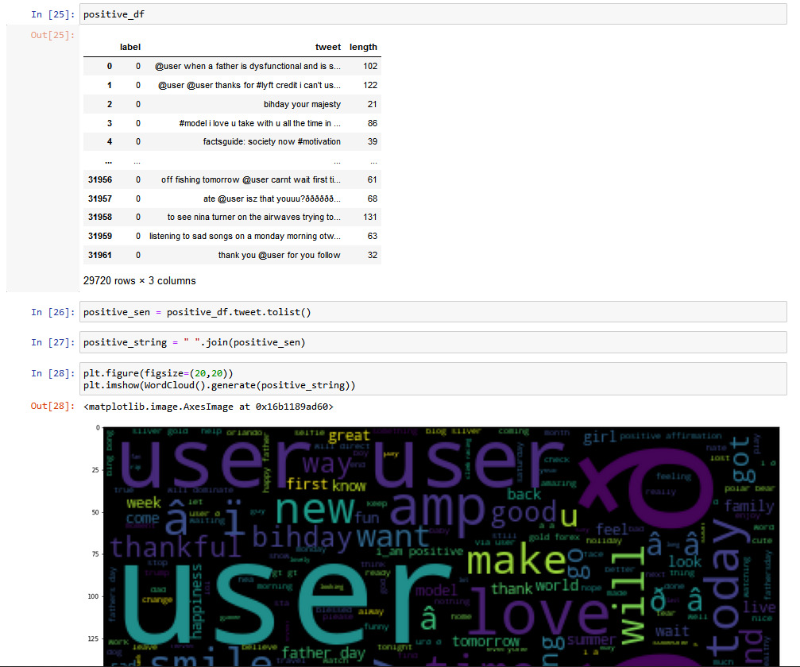
Word Cloud PLot of positive tweets

Slide 20
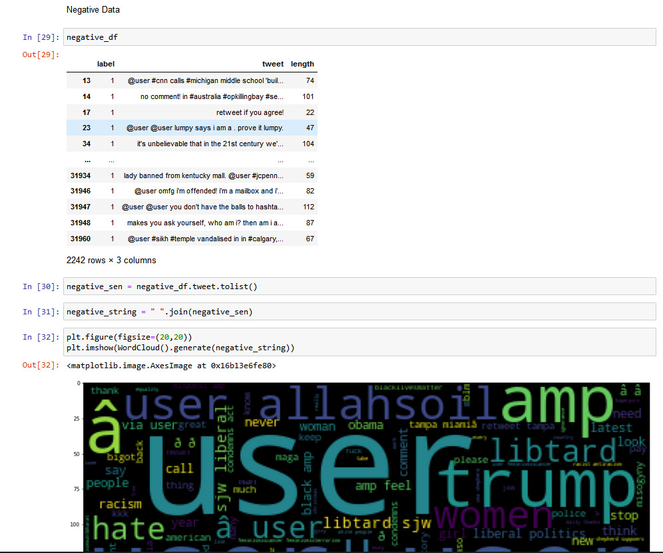
Word Cloud PLot of Negative tweets.

Slide 21
Naive Bayes
Naive Bayes classifiers are a collection of classification algorithms based on Bayes’ Theorem. It is not a single algorithm but a family of algorithms where all of them share a common principle, i.e. every pair of features being classified is independent of each other.
Bayes’ Theorem finds the probability of an event occurring given the probability of another event that has already occurred. Bayes’ theorem is stated mathematically as the following equation:

Slide 22

Where A and B are events
Basically, we are trying to find probability of event A, given the event B is true. Event B is also termed as evidence.
P(A) is the priori of A (the prior probability, i.e. Probability of event before evidence is seen). The evidence is an attribute value of an unknown instance(here, it is event B).

Slide 23
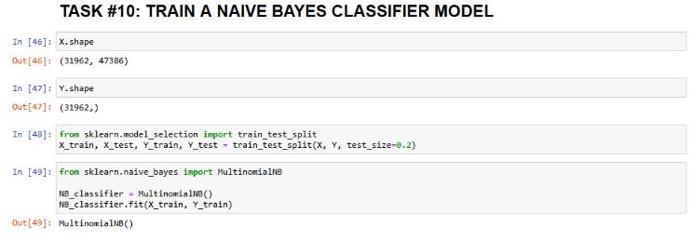
P(A|B) is a posteriori probability of B, i.e. probability of event after evidence is seen

Slide 24
Count Vectorization
When we come across any model in data science, they can only take in numeric inputs.
Count Vectorization does this exact thing, it converts a group of words into an array of binary numbers.
Count Vectorization involves counting the number of occurrences each words appears in a document (i.e distinct text such as an article, book, even a paragraph!). Python’s Sci-kit learn library has a tool called CountVectorizer to accomplish this, which we have used in this project.

Slide 25
Example sentence: “The weather was wonderful today and I went outside to enjoy the beautiful and sunny weather.”
This is the first paper. [ [0 1 1 1 0 0 1 0 1]
This paper is the second paper. [0 2 0 1 0 1 1 0 1]
And this is the third one. [1 0 0 1 1 0 1 1 1]
Is this the first paper? [0 1 1 1 0 0 1 0 1]]

Slide 26
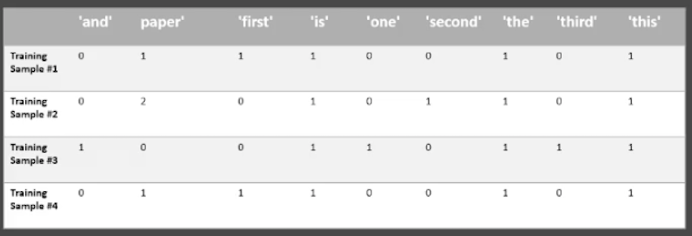

Slide 27
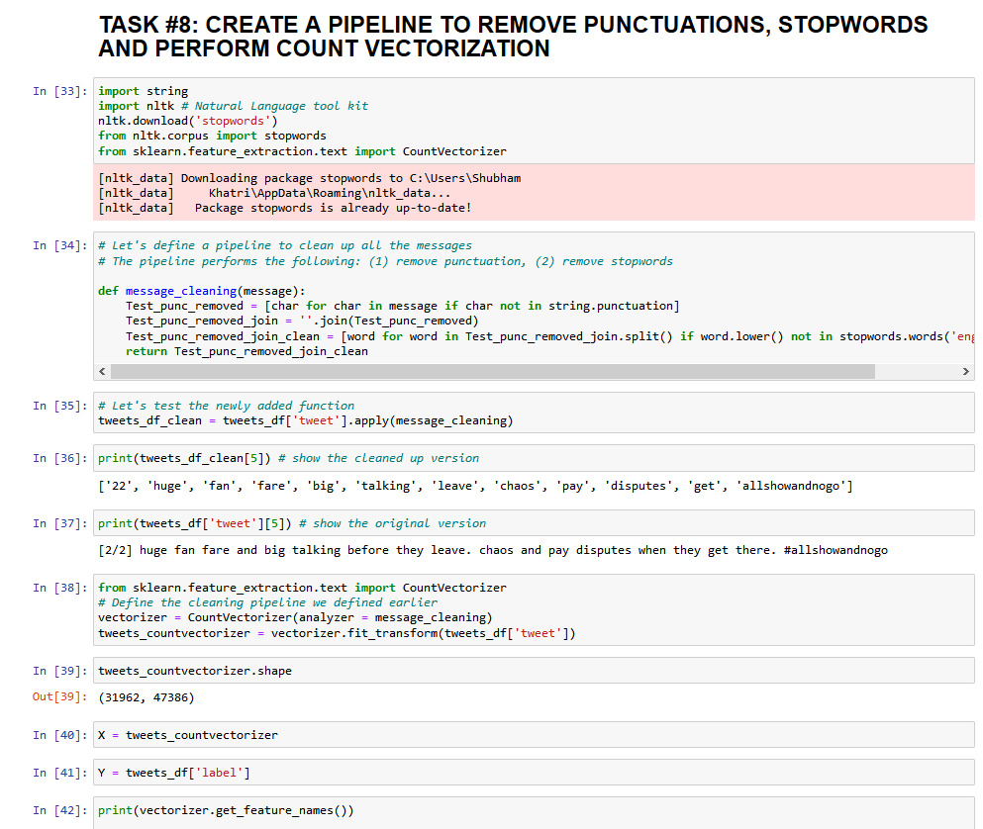

Slide 28
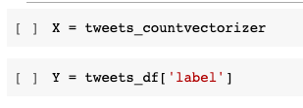
Training the Model
Parameters That go in the model:
X = the count vectorizer of the tweets
Y = the labels associated with each tweet

Slide 29
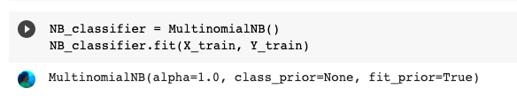
Validation Technique used:Holdout
The dataset is split into training and test set
80%of the data is used for training and 20% used for testing
Multinomial NB Classifier Used

Slide 30
Performance Measures Accuracy is characterized as the proportion of genuine expectation to the all outnumber of tweets in the set. Accuracy=(TP+TN)/TOTAL

Slide 31
Precision is the portion of anticipated extremity that are accurately perceived. Precision is characterized as
P=TP/(TP+FP)
Recall just is the division of no. of the right prediction of a specific polarity over the real no. of tweets with that polarity. Recall is characterized as
R=TP/(TP+FN)
F1-score=(2*R*P)/(R+P)
F1-score is characterized as the harmonic mean of Recall(R) and Precision(P) and numerically equation is given by
TP is no. of true positives i.e., number of right ordered tweets, FN is no. of false negatives, and FP is the no. of false positives.

Slide 32
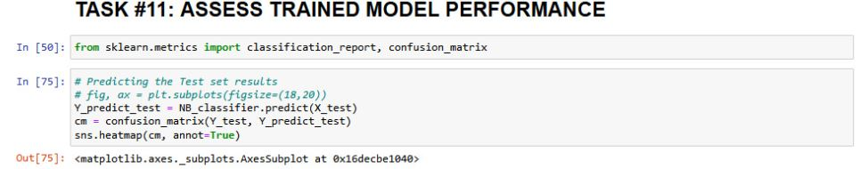

Slide 33
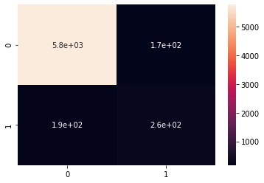
Confusion Matrix

Slide 34
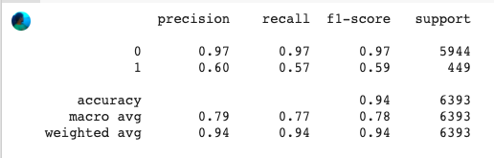
Complete Classification Report

Slide 35
AUC Score
AUC is the best possible way to access a trained machine learning model.
Basically it is the plot between the True Positive Rate and the False Positive Rate, And the AUC Score is Calculated by the area under that curve.

Slide 36
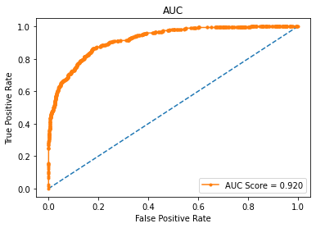
So here for our model we have an AUC Score of 0.920 which is considered to be extremely good.

Slide 37
REFERENCES
A.Pak and P. Paroubek. „Twitter as a Corpus for Sentiment Analysis and Opinion Mining". In Proceedings of the Seventh Conference on International Language Resources and Evaluation, 2010, pp.1320-1326
R. Parikh and M. Movassate, “Sentiment Analysis of UserGenerated Twitter Updates using Various Classi_cation Techniques",CS224N Final Report, 2009
Go, R. Bhayani, L.Huang. “Twitter Sentiment Classification Using Distant Supervision". Stanford University, Technical Paper,2009
Aliza Sarlan, Chayanit Nadam and Shuib Basri, “Twitter Sentiment Analysis”, 2014 International Conference on data Technology and Multimedia (ICIMU), Putrajaya, Malaya Gregorian calendar month eighteen – twenty, 2014.

Slide 38
5. Alexander Pak, Apostle Paroubek, “Twitter as a Corpus for Sentiment Analysis and Opinion Mining”, Proceedings of the International Conference on Language Resources and analysis, 6. LREC 2010, 17-23 could 2010, Valletta, Malta,2010
6.https://ijarcce.com/upload/2016/december-16/IJARCCE%2074.pdf
7.https://arxiv.org/ftp/arxiv/papers/1601/1601.06971.pdf
8.https://www.researchgate.net/publication/301408174_Twitter_sentiment_analysis
9.https://thesai.org/Downloads/Volume10No2/Paper_48-A_Study_on_Sentiment_Analysis_Techniques.pdf
10.https://www.researchgate.net/publication/304579281_Sentiment_Analysis_on_Twitter

Slide 39
THANK YOU

